Slide 1

MRI-based brain tumor image detection using CNN based deep learning method
Karthik Kakumanu –AP21110010263
Jai Venkata Koushik –AP21110010325
Sowjanya Tuluva –AP21110010271
Bindu Sai – AP21110010270
Shalini –AP211100101192

Slide 2
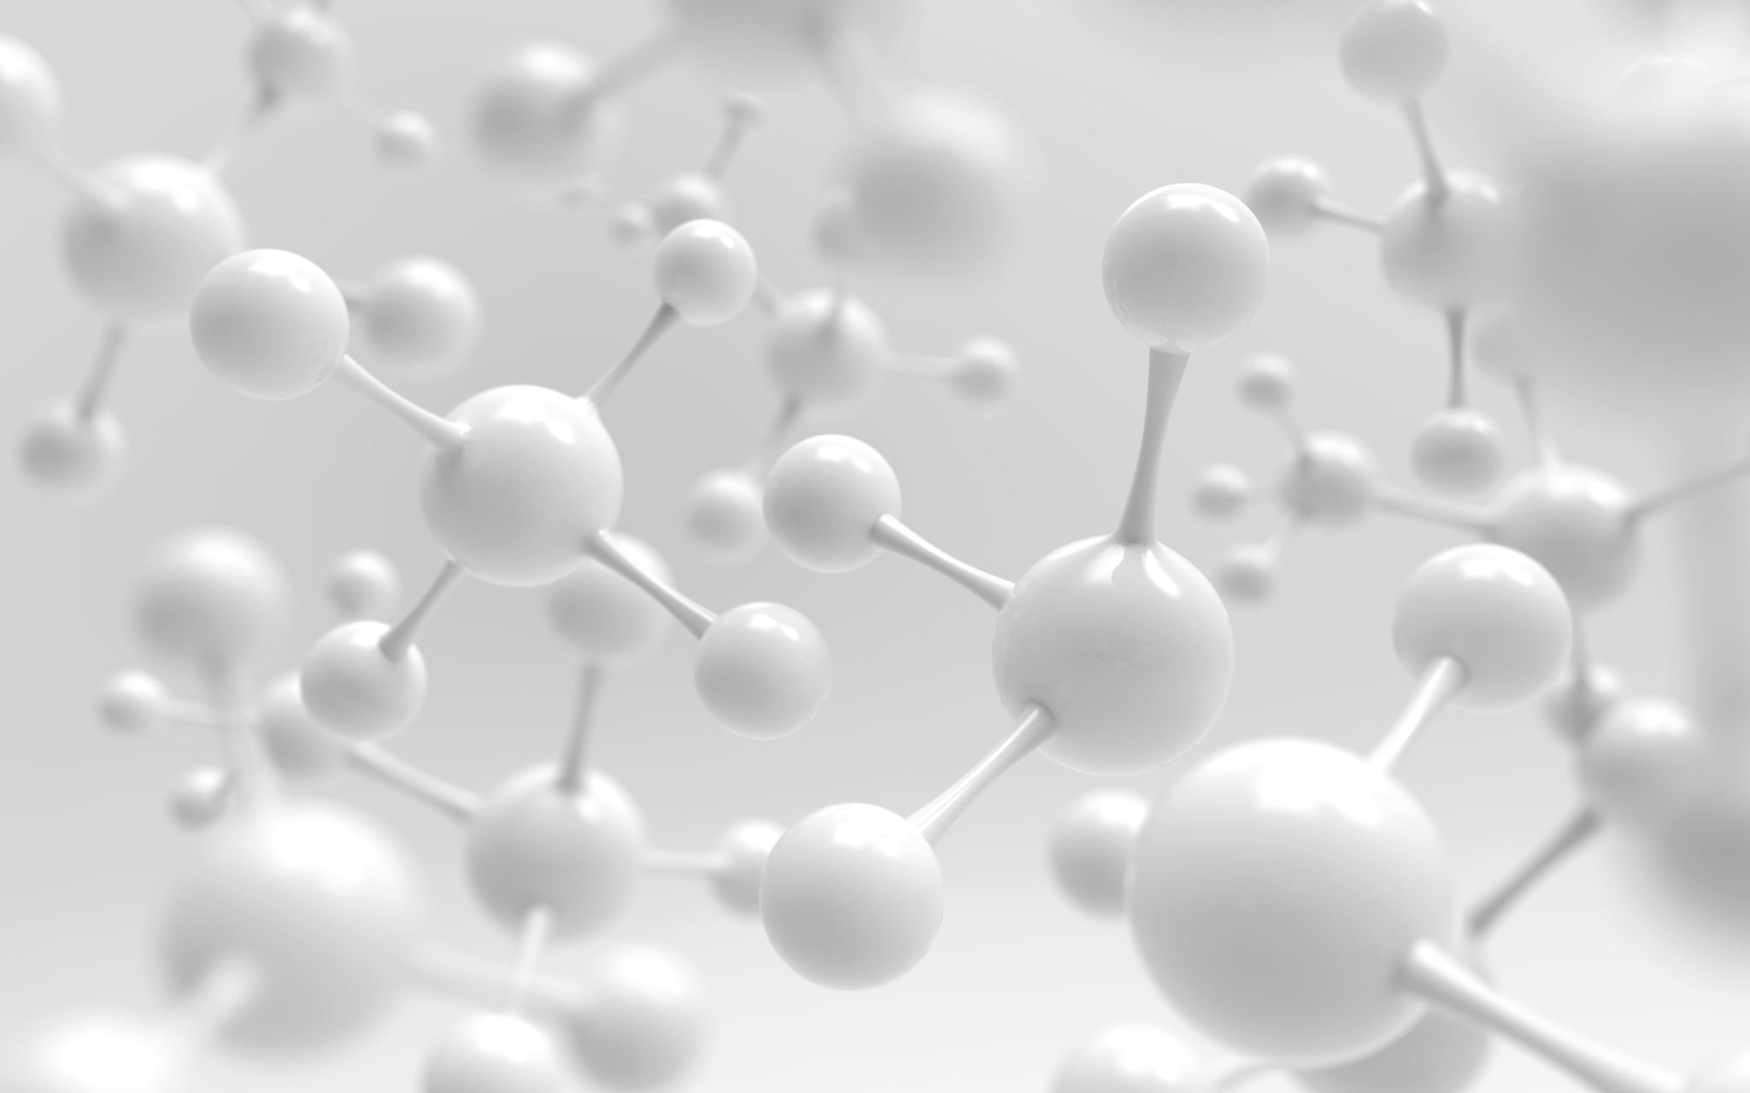
Abstract:-
Medical imaging plays a pivotal role in early tumor detection and diagnosis, with Magnetic Resonance Imaging (MRI) emerging as a valuable tool due to its superior soft tissue contrast. This project employs Convolutional Neural Networks (CNNs) as a deep learning method for the automatic detection of tumors in MRI scans. The proposed model harnesses the power of CNNs to learn complex spatial features from MRI images, thereby enhancing the accuracy of tumor detection. In this project, we present a systematic analysis of our CNN-based approach, showcasing its effectiveness in improving the detection of tumors, while reducing false-positive rates. Experimental results demonstrate the model's superior performance compared to traditional methods, offering potential for early tumor detection and better patient outcomes.

Slide 3

Introduction:-
In the realm of medical diagnostics, the differentiation of brain tumors from healthy tissues in MRI scans poses a formidable challenge due to their visual similarities. To address this, we present a groundbreaking solution in the form of a Convolutional Neural Network (CNN) designed for the automated detection of brain tumors. This innovative approach aims to revolutionize the field of diagnostics by enhancing the accuracy of cancer diagnosis, mitigating errors, and expediting the imaging process through the power of deep learning.
Our CNN-based system ensures faster and more precise information extraction, thereby significantly improving the landscape of medical imaging. This not only facilitates quicker diagnosis but also empowers healthcare professionals to make timely and well-informed treatment decisions. The seamless integration of this technology into healthcare systems equips clinicians with the tools to provide superior patient care, ultimately leading to enhanced treatment outcomes and a more streamlined healthcare process.

Slide 4
CODE ARCHITECTURE:-
Architecture 1:-
The first convolutional neural network (CNN) architecture consists of multiple layers designed to extract hierarchical features from input images. The model begins with four convolutional layers, each followed by batch normalization and max-pooling operations. The convolutional layers progressively increase the number of filters, capturing more complex patterns. Afterward, the feature maps are flattened and fed into two fully connected layers with batch normalization. The final output layer utilizes softmax activation for multi-class classification. This architecture follows a systematic pattern of convolutional and pooling operations, promoting feature extraction and abstraction.

Slide 5
CODE ARCHITECTURE:-
Architecture 2:
The second CNN architecture is inspired by the VGG-like design, characterized by a series of convolutional blocks with increasing depth. Each block contains multiple convolutional layers with rectified linear unit (ReLU) activation, maintaining a consistent filter size and padding. Max-pooling is applied after each block to reduce spatial dimensions. The model concludes with fully connected layers, incorporating dropout for regularization. The architecture is known for its deep stacking of convolutional layers, promoting a more nuanced understanding of image features. The final layer utilizes softmax activation for multi-class classification. This design is reminiscent of the VGG network, emphasizing deep feature learning and abstraction

Slide 6
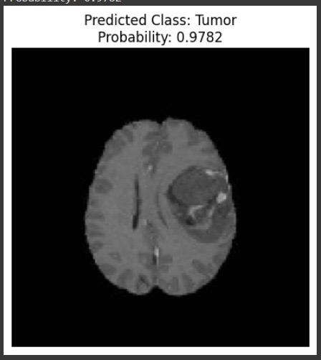
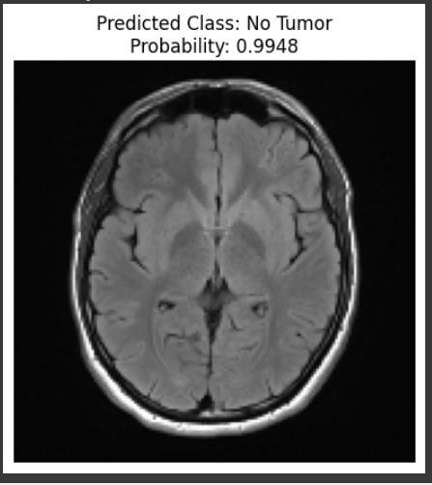
Results:

Slide 7
Conclusion:-
In this project, we explored two distinct Convolutional Neural Network (CNN) architectures to enhance brain tumor detection in MRI scans. The first architecture systematically incorporated four convolutional layers, followed by batch normalization and max-pooling operations, progressively increasing the number of filters to capture complex patterns. It also included fully connected layers with batch normalization. The second architecture drew inspiration from the VGG-like design, featuring multiple convolutional layers within each block, maintaining a consistent filter size and using ReLU activation. Both architectures concluded with a softmax activation layer for multi-class classification.
These architectures offer valuable tools for medical image analysis, particularly in the context of brain tumor detection. The first architecture excels in systematic feature extraction, while the second prioritizes deep feature learning and abstraction. Both have the potential to improve the accuracy and efficiency of brain tumor diagnosis, enabling better patient care, timely treatment decisions, and enhanced treatment outcomes in the field of neurology.

